Slide 1

BASIC ELECTRICAL AND ELECTRONICS ENGINEERING
Course Code: CSE1002
SCHOOL OF COMPUTER SCIENCE ENGINEERING AND APPLICATIONS
Mrunmayee Rahate
Assistant Professor, DYPIU

Slide 2
Module 4: Operational Amplifiers (OP-AMPS)
Lecture 1: Introduction to Differential Amplifier, Ideal OP-AMP Characteristics, Inverting and Non Inverting Configurations

Slide 3
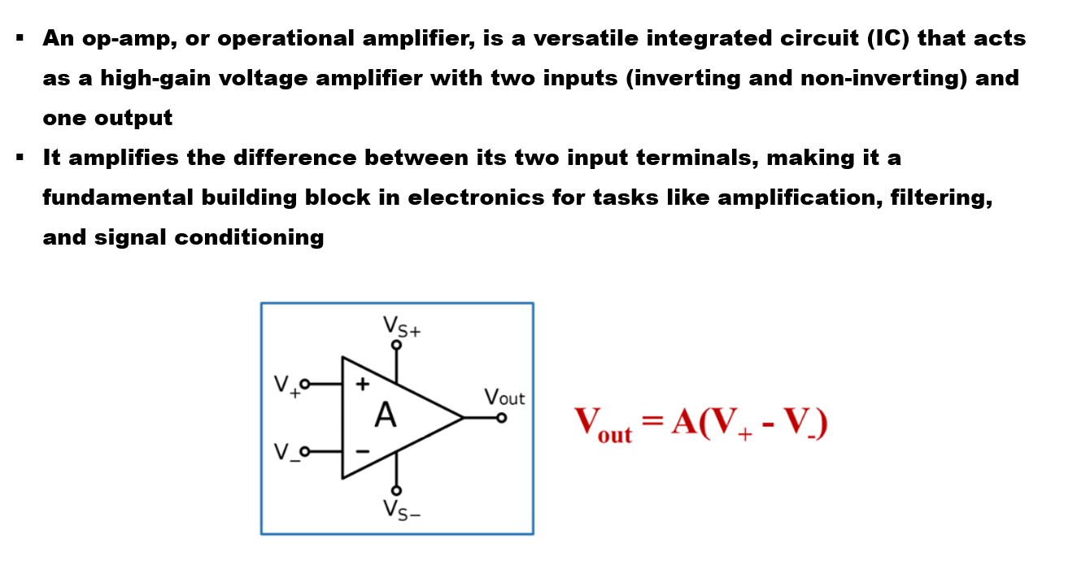
Operational Amplifier

Slide 4
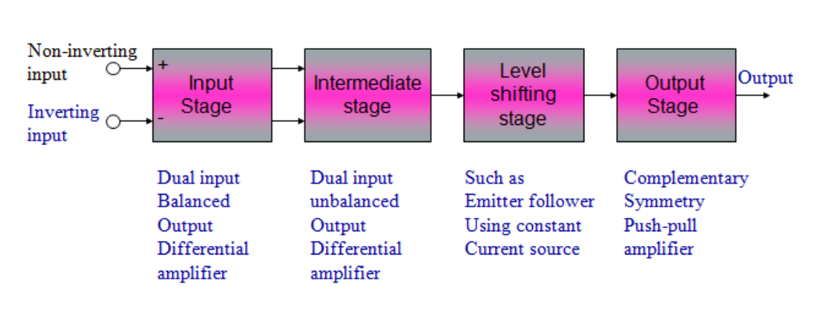
Operational Amplifier: Functional Block Diagram

Slide 5
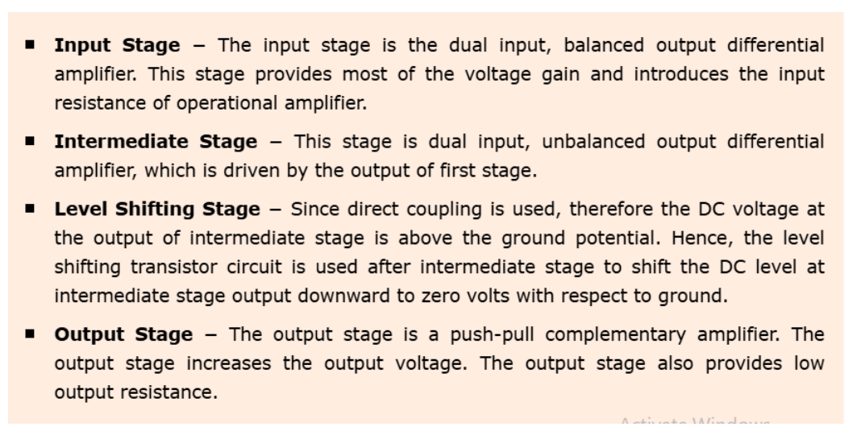
Operational Amplifier: Functional Block Diagram

Slide 6
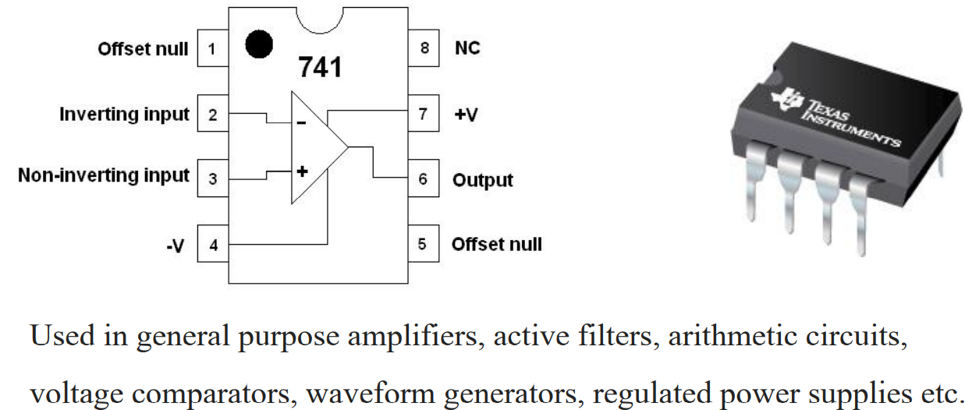
Operational Amplifier: general purpose Ic
Notes:
The offset null pins (1 and 5) on the IC 741 are used to eliminate the output offset voltage, which is a small voltage that appears at the output even when there is no input signal

Slide 7
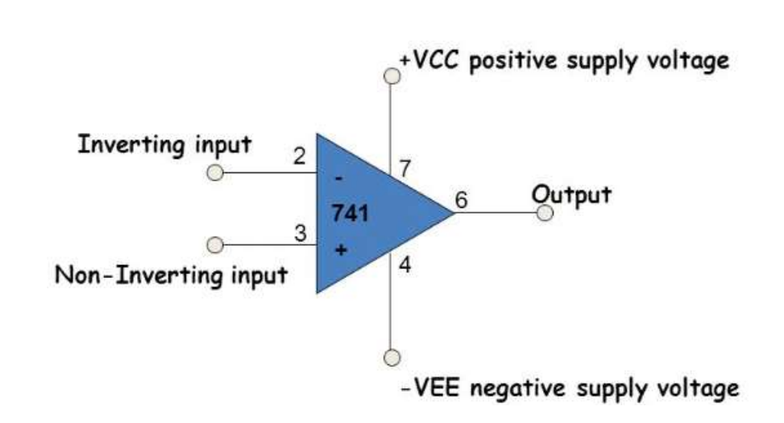
Operational Amplifier: Symbol and Terminal

Slide 8
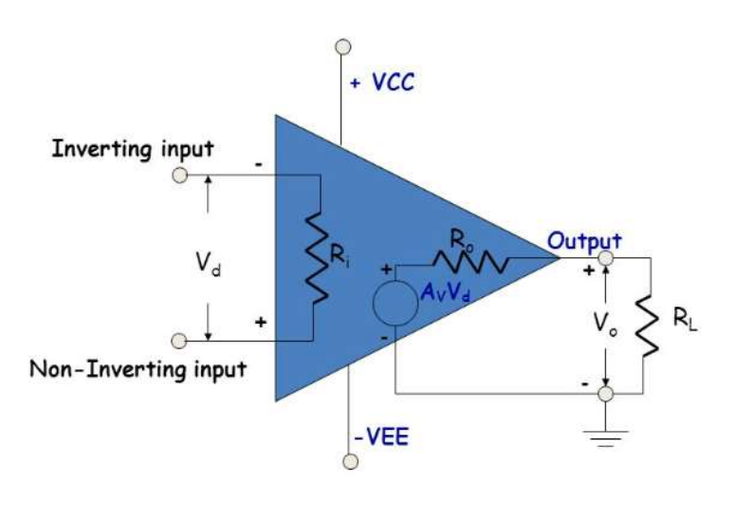
Operational Amplifier: Equivalent Circuit

Slide 9
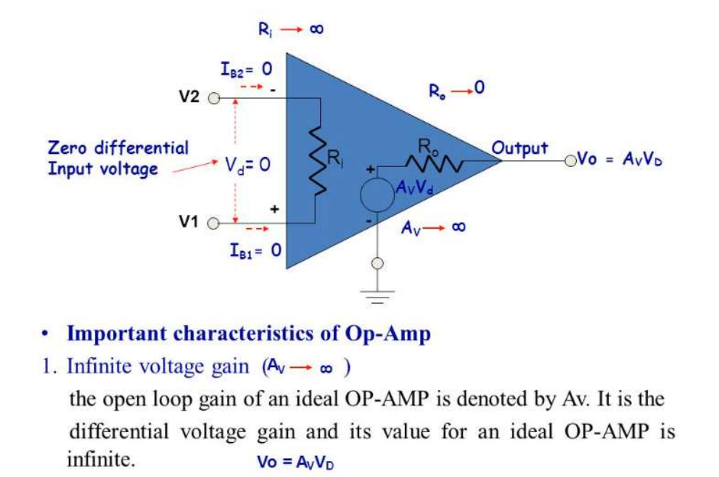
Operational Amplifier: Ideal Case

Slide 10
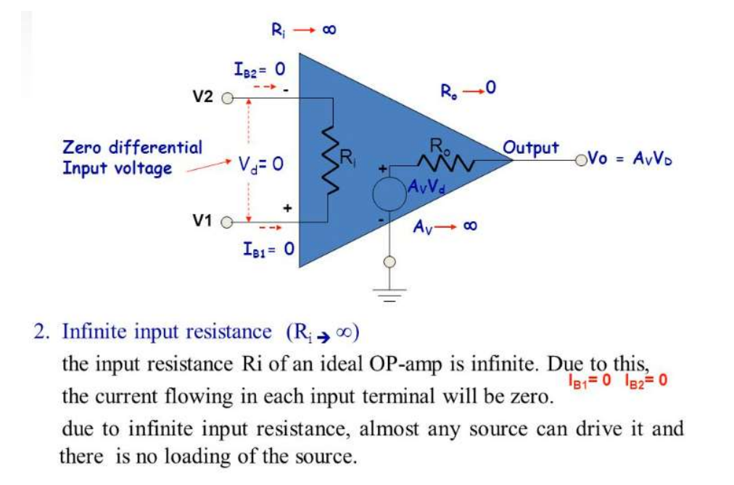
Operational Amplifier: Ideal Case

Slide 11
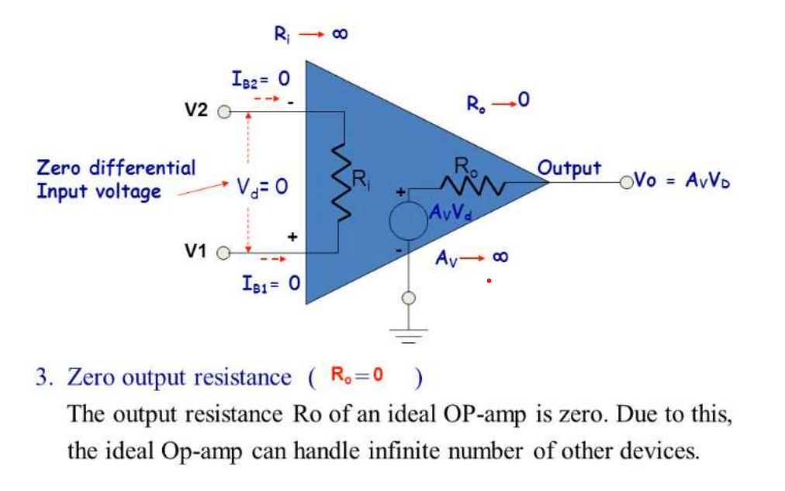
Operational Amplifier: Ideal Case

Slide 12
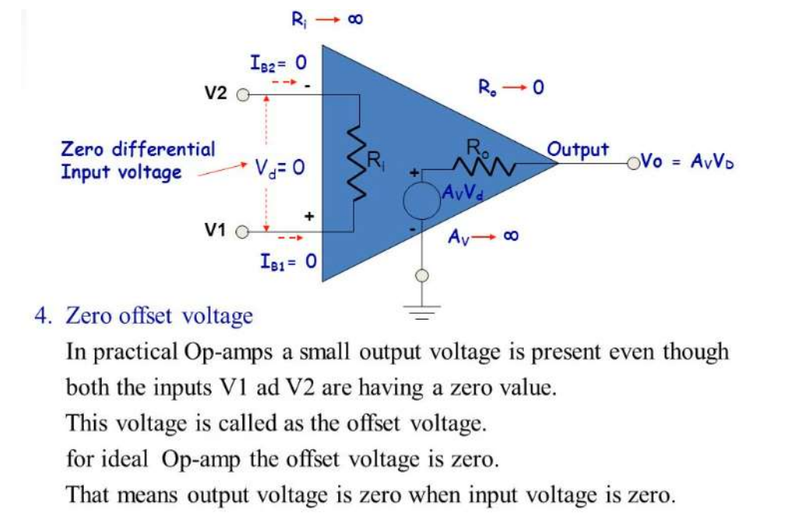
Operational Amplifier: Ideal Case

Slide 13
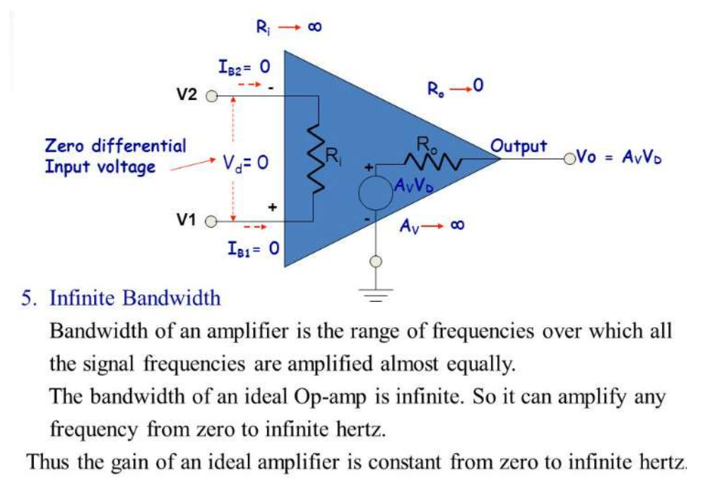
Operational Amplifier: Ideal Case

Slide 14
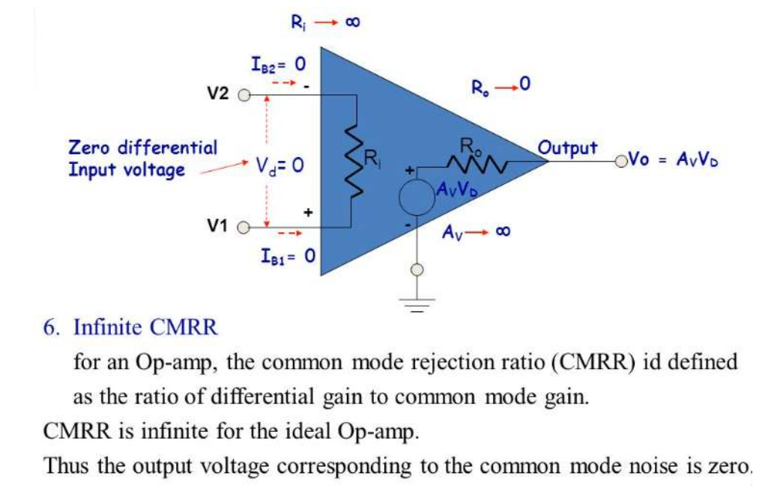
Operational Amplifier: Ideal Case

Slide 15
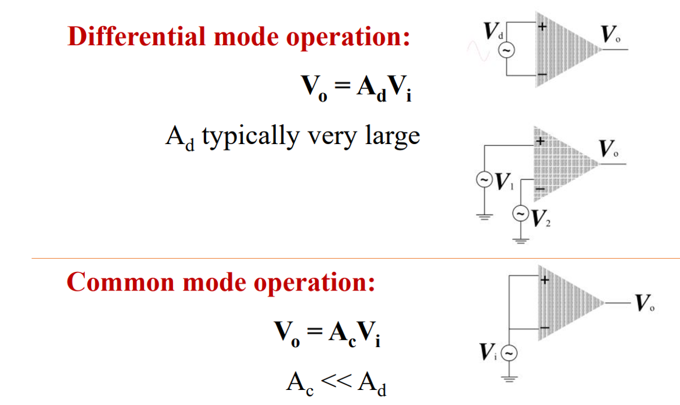
Operational Amplifier: CMRR

Slide 16
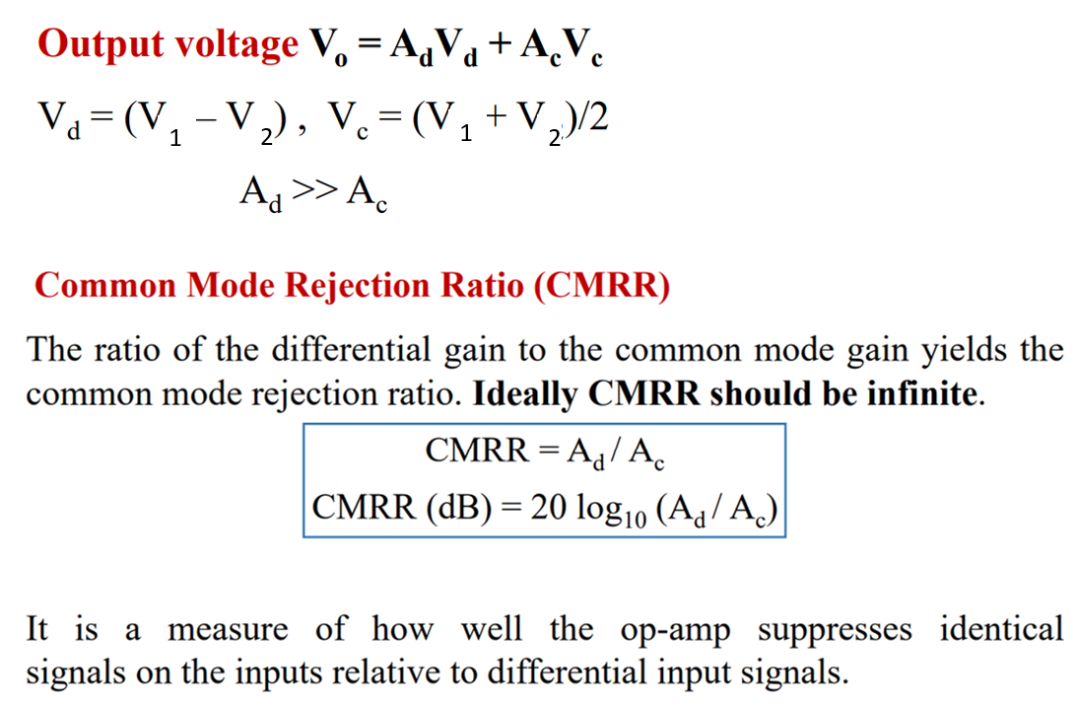
Operational Amplifier: CMRR

Slide 17
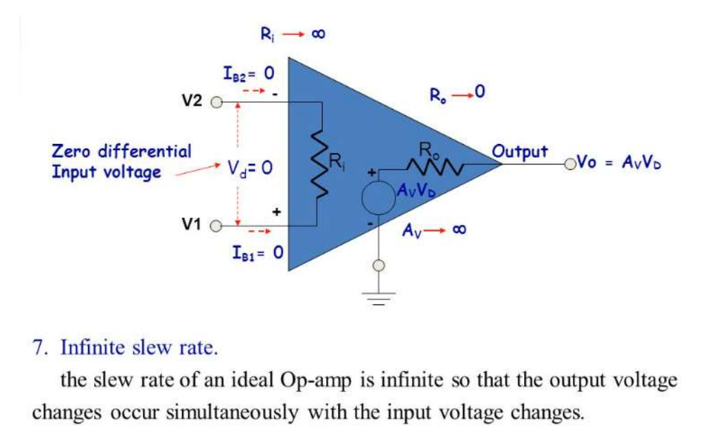
Operational Amplifier: Ideal Case

Slide 18
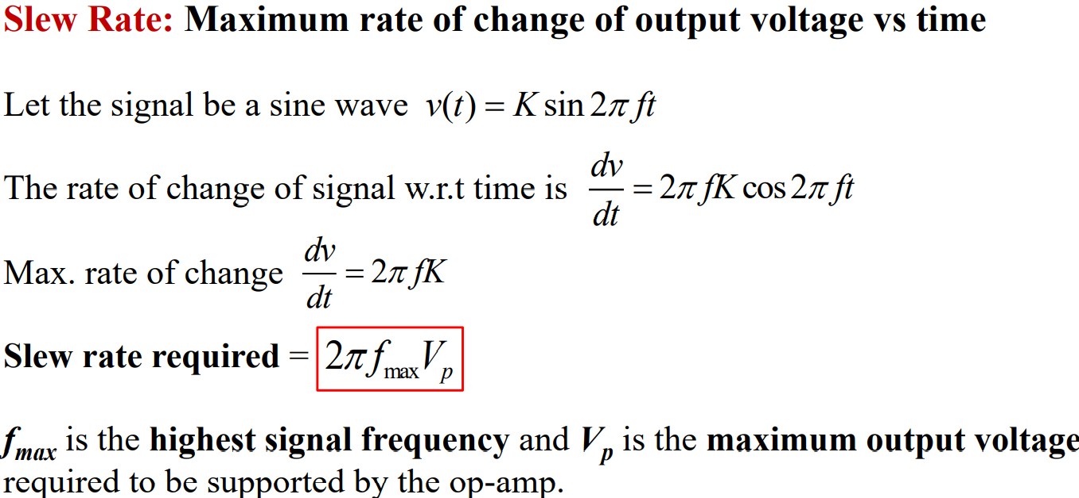
Operational Amplifier: Slew Rate

Slide 19
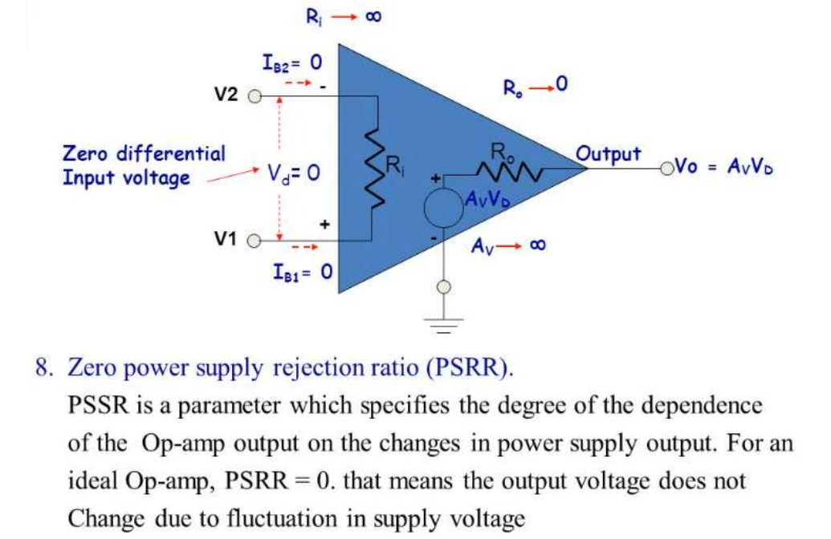
Operational Amplifier: Ideal Case

Slide 20
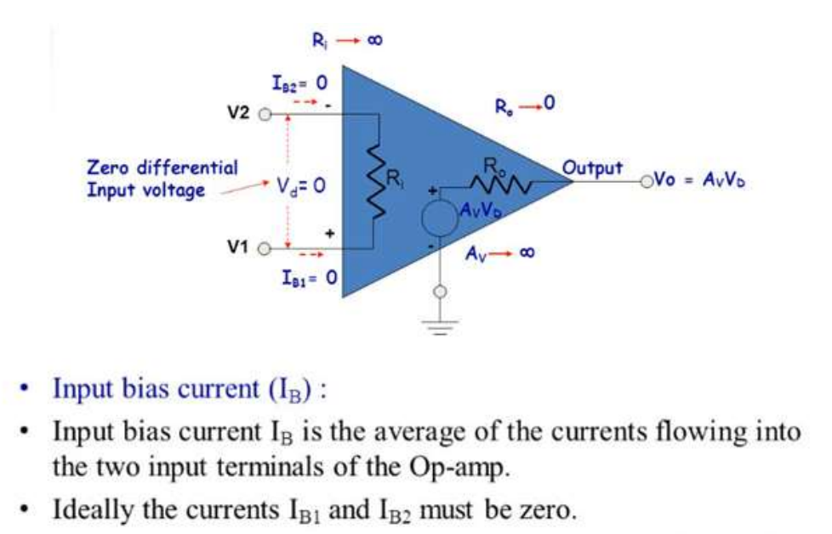
Operational Amplifier: Ideal Case

Slide 21
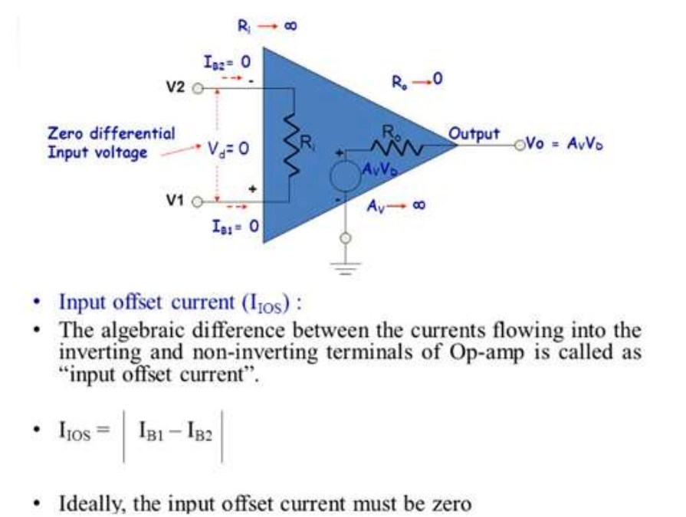
Operational Amplifier: Ideal Case

Slide 22
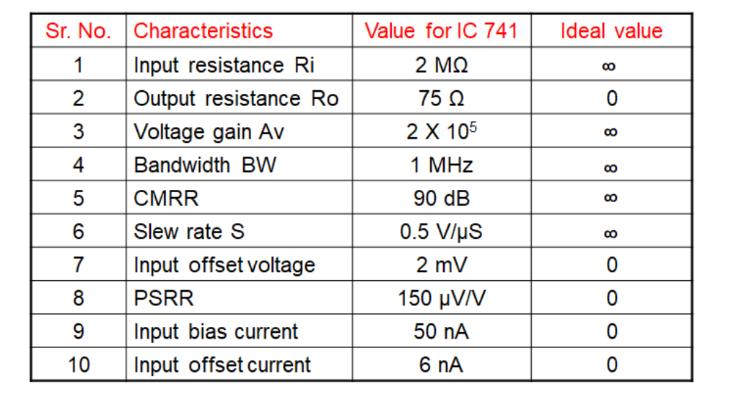
Operational Amplifier: Ideal and Practical Values
of Performance Parameters

Slide 23
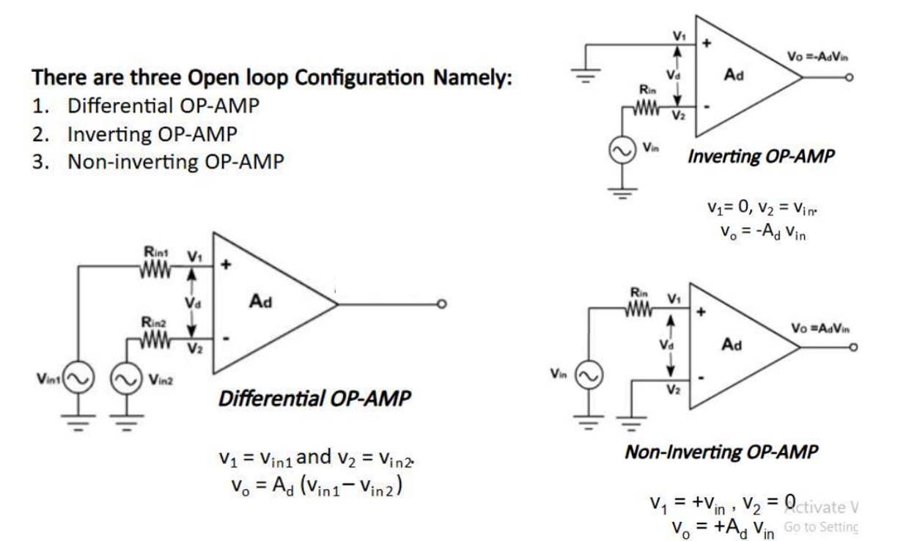
Operational Amplifier: Open Loop Configuration

Slide 24
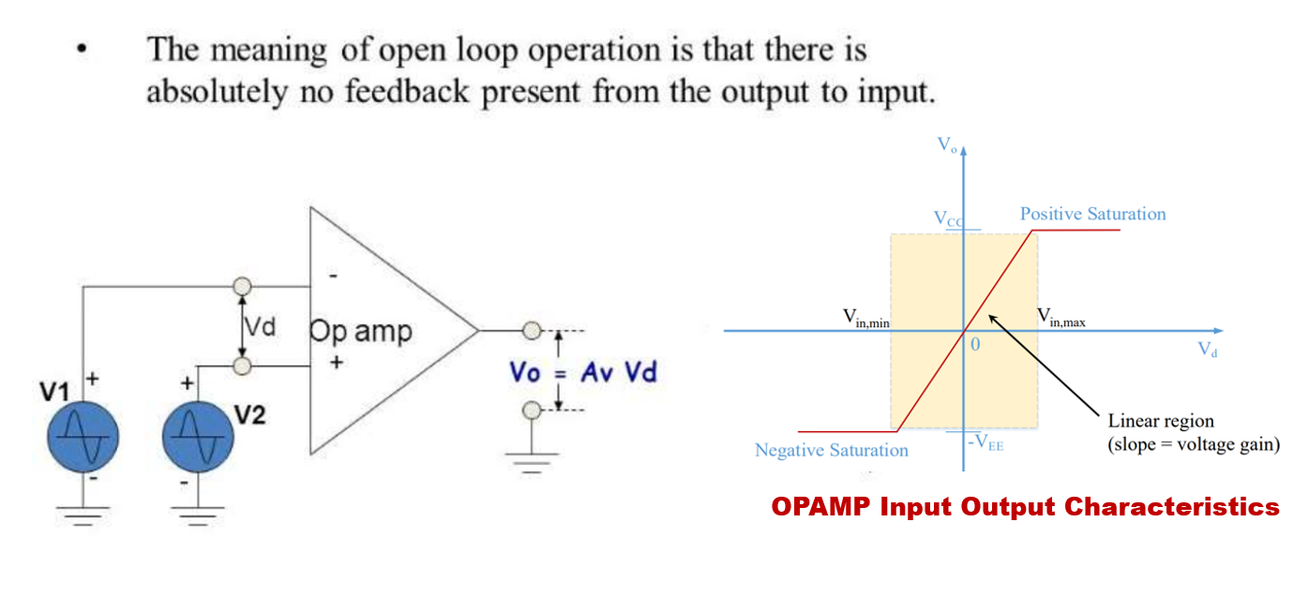
Operational Amplifier: Open Loop Configuration
- Drawback

Slide 25
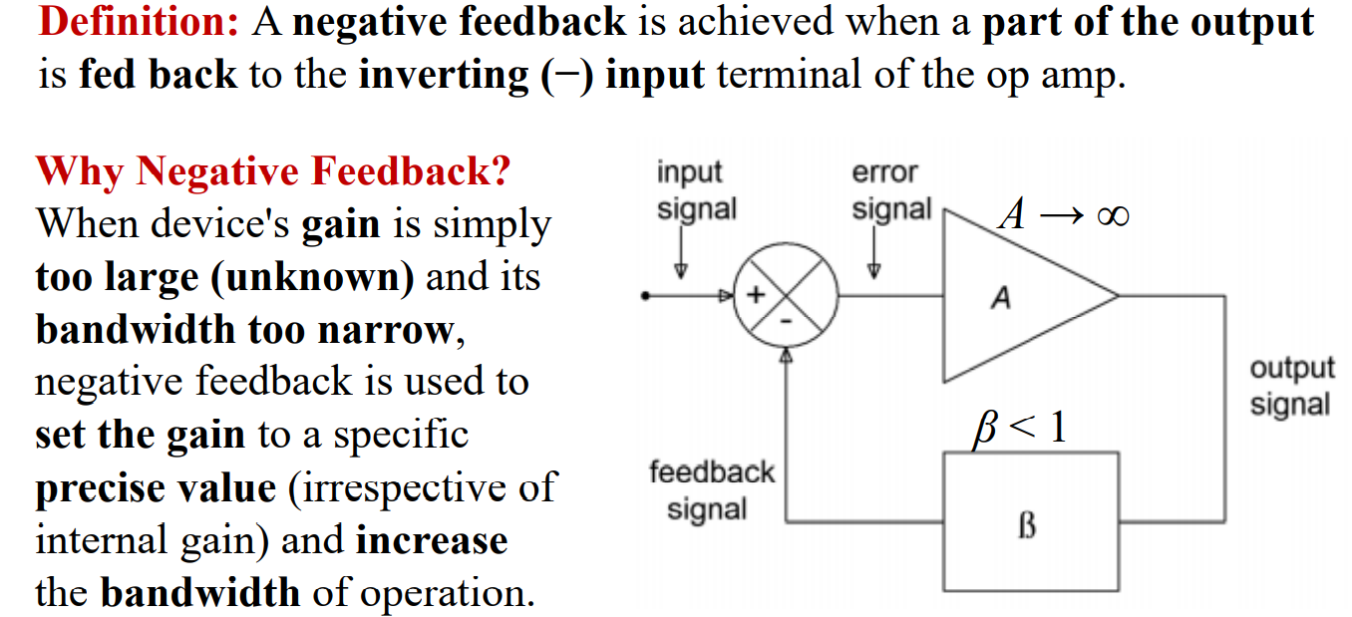
Operational Amplifier: Concept of Negative feedback

Slide 26
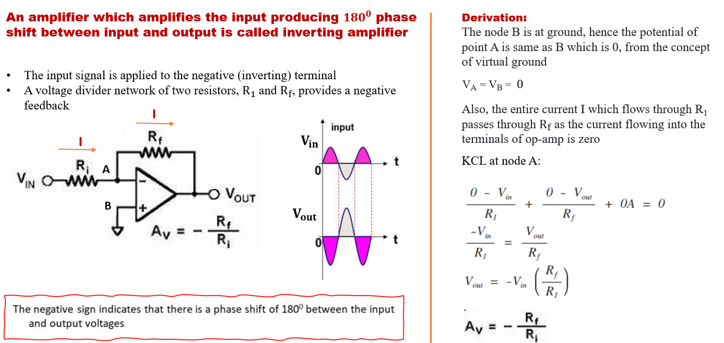
Operational Amplifier: Closed Loop Configuration -
Inverting Amplifier

Slide 27
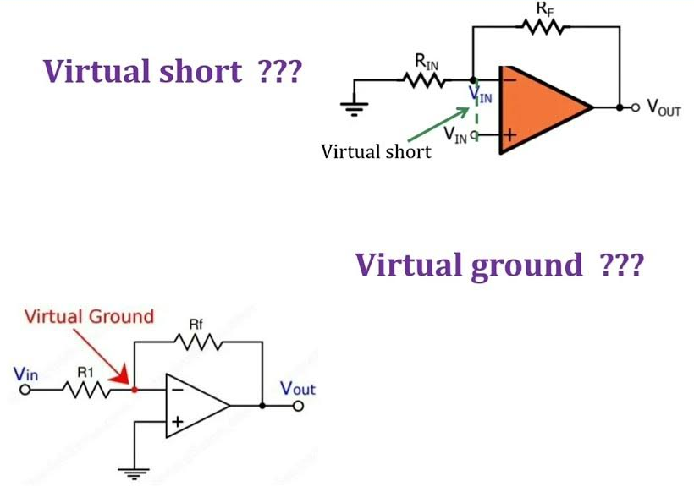
Operational Amplifier: concept of virtual ground and virtual short

Slide 28
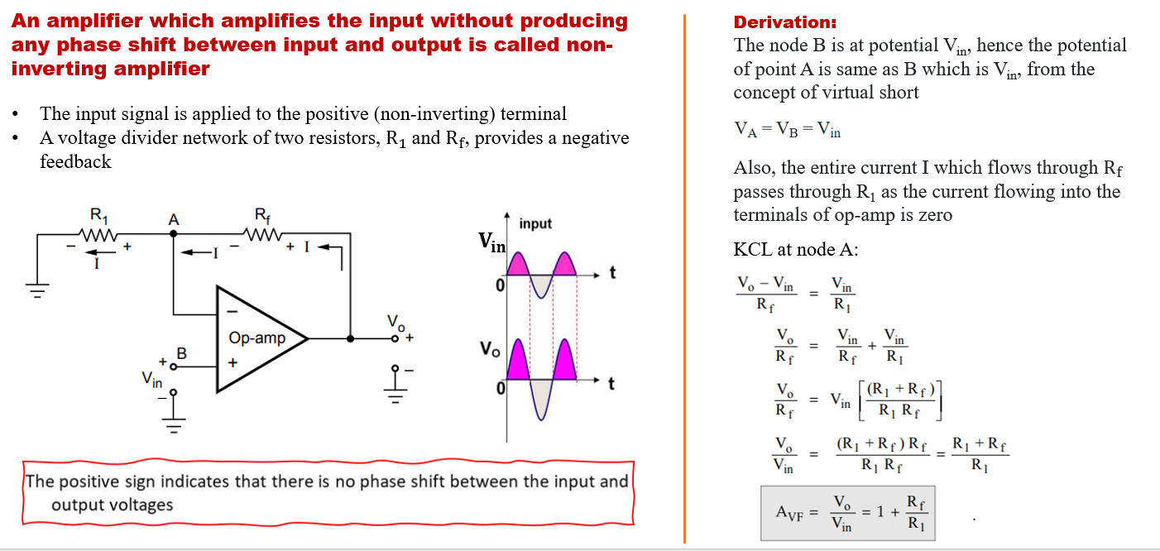
Operational Amplifier: Closed Loop Configuration -
Non - Inverting Amplifier

Slide 29
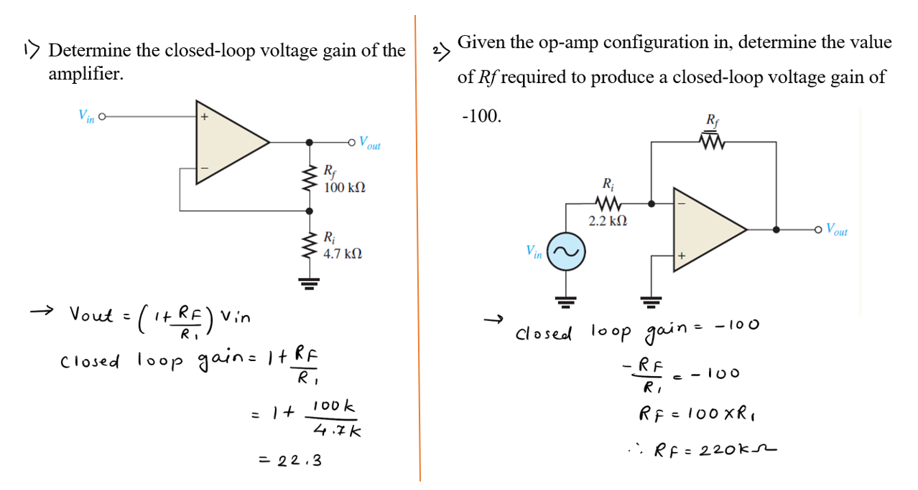
Operational Amplifier: numerical

Slide 30
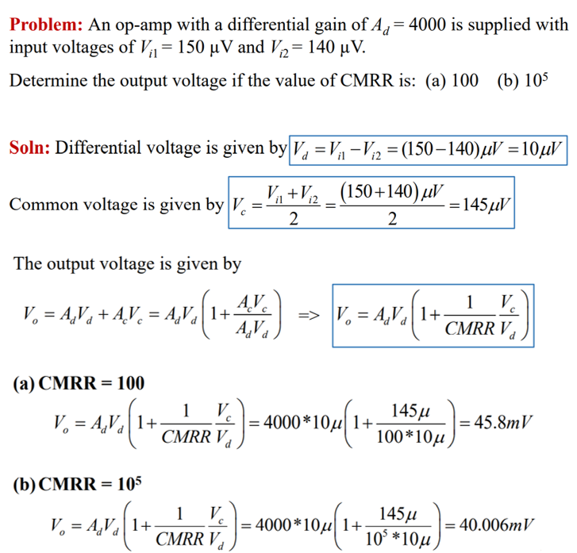
Operational Amplifier: numerical

Slide 31
Thank You !!!

